Slide 1

6TH SEMESTER - COMPUTER GRAPHICS AND VISUALIZATION (18CS62) MODULE-5 INPUT AND INTERACTION ,CURVES AND COMPUTER ANIMATION
SYED MATHEEN PASHA
Assistant professor
DEPARTMENT OF COMPUTER SCIENCE AND ENGINEERING
SAI VIDYA INSTITUTE OF TECHNOLOGY

Slide 2
Input and Interaction

Slide 3
Introduction:
We now turn to the development of interactive graphics programs.
Our discussion has three main parts
First, we consider the variety of devices available for interaction
We then consider client-server networks and client-server graphics
Finally we develop a paint program that demonstrates the important features of interactive graphics programming.

Slide 4
1. Interaction
One of the most important advances in computer technology was enabling users to interact with computer displays
Ivan Sutherland’s Project Sketchpad launched the present era of interactive computer graphics
Since 1963 when this work was published there have been many advances in both hardware and software, but the viewpoint ideas he introduced still dominate computer graphics.

Slide 5
OpenGL does not support interaction directly
windowing and input functions were left out of the API for portability reasons.
We can avoid potential difficulties by using a simple library, or toolkit, as we did in Chapter 2.
Our use of the GLUT toolkit will enable us to avoid the complexities inherent in the interactions among the windowing system
Our outline for this chapter looks like this:
We start by describing several interactive devices and how to interact with them
We then put these devices in the setting of a client-server network.
Then, we introduce an API for minimal interaction.
Finally, we shall generate sample programs.

Slide 6
2. Input Devices
From the physical perspective, each device has properties that make it more suitable for certain tasks than for others.
There are two primary types of physical devices:
Pointing Devices
Keyboard Devices

Slide 7
2.1 Physical Input Devices
The pointing device allows the user to indicate a position on the screen,
and almost always incorporates one or more buttons
The keyboard device is almost always a physical keyboard,
but can be generalized to include any device that returns character codes to a program

Slide 8
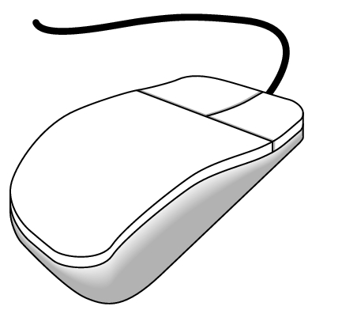
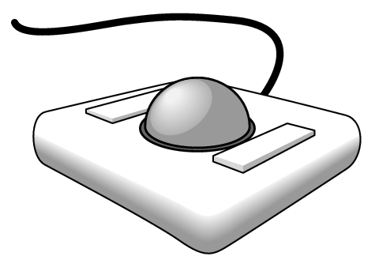
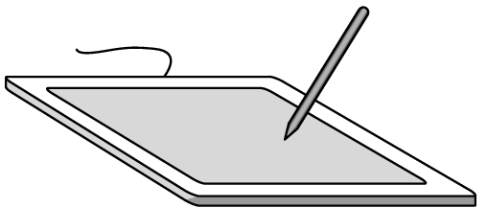
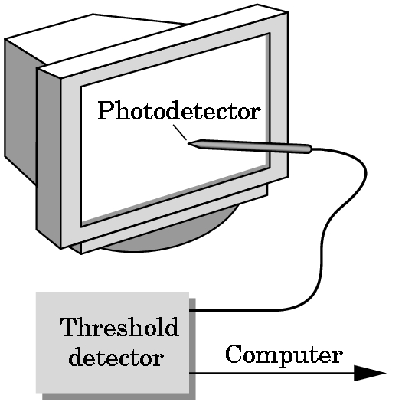
Pointing devices can be broken into two subcategories
relative-position devices
absolute- position devices

Slide 9
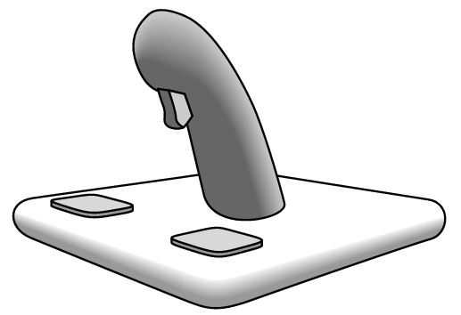
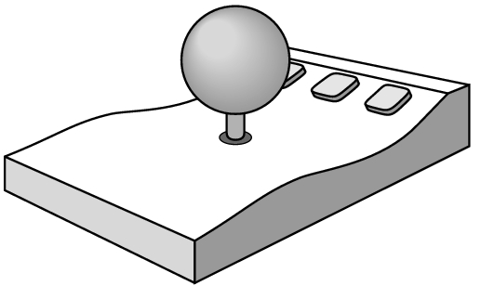
Other Pointing Devices
Joystick
SpaceBalls

Slide 10
2.2 Logical Devices
Two major characteristics describe the logical behavior of an input device
What measurements the device returns to the user program
When the device returns those measurements.
Some API’s such as PHIGS and GKS consider six classes of logical input devices.
OpenGL does not follow this approach, but we will look at these classes briefly and see how OpenGL provides similar functionality

Slide 11
1. String
a device that provides ASCII strings to the user program.
Most windowing systems and OpenGL do not distinguish between a logical string device and the keyboard.
2. Locator
a device that provides a position in world coordinates to the user program.
It is usually implemented via a pointing device, such as a mouse or a trackball.
In OpenGL we usually have to do the conversion from screen coordinates to world coordinates within our own programs

Slide 12
3. Pick
a device that returns the identifier of an object to the user program.
It is usually implemented with the same device as the locator, but has a separate software interface
In OpenGL, we can use a process called selection to accomplish picking.
4. Choice
a device that allows the user to select one of a discrete number of options.
In OpenGL we can use various widgets provided by the windowing system.

Slide 13
5. Dial
Dials provide analog input to the user program
Here again widgets provide this facility through graphical devices, such as slidebars
6. Stroke
A device that returns an array of locations.
Although we can think of a stroke as similar to multiple locators, it is often implemented such that an action, such as pushing down a mouse button, starts the transfer of data into the specified array, and a second action, such as the releasing of the button, ends the transfer

Slide 14
2.3 Measure and Trigger
The manner by which physical and logical input devices provide input to an application program can be described in terms of two entities:
Measure -- what is returned
Trigger -- when it is returned
Measure can also include status information

Slide 15
2.4 Input Modes
We can obtain the measure of a device in three distinct modes.
Each mode is defined by the relationship between the measure process and the trigger.
The three modes are:
Request Mode
Sample-Mode
Event Mode

Slide 16
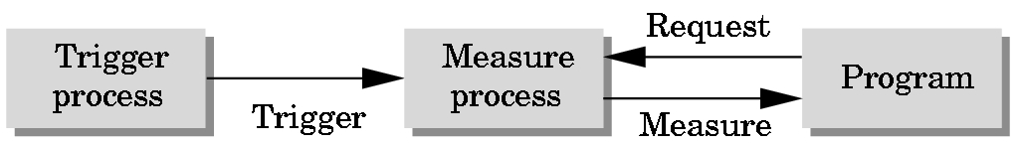
Request Mode:
The measure of the device is not returned to the program until the device is triggered.
This mode is standard in non-graphical applications such as typical C programs
input is buffered until the trigger is hit
for scanf( ) the trigger is the “enter” key.

Slide 17
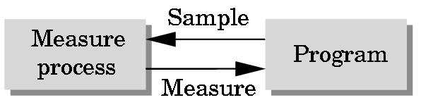
Sample Mode:
The input is immediate
As soon as the function call in the user program is encountered, the measure is returned.
Both request mode and sample mode are useful for situations where the program guides the user, but are not useful in applications where the user controls the flow of the program. (Flight Simulator)

Slide 18
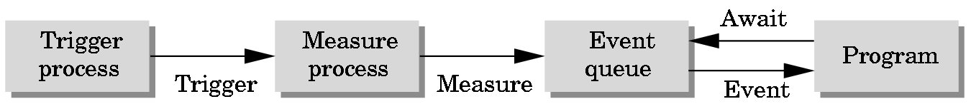
Event Mode:
Each time a device is triggered, an event is generated and placed into an event queue. From here there are two approaches
1) The program can then get events off the queue, and “service” them.
2) associate a “callback” function with a specific type of event and when that event comes to the front of the queue, that function is automatically executed.

Slide 19
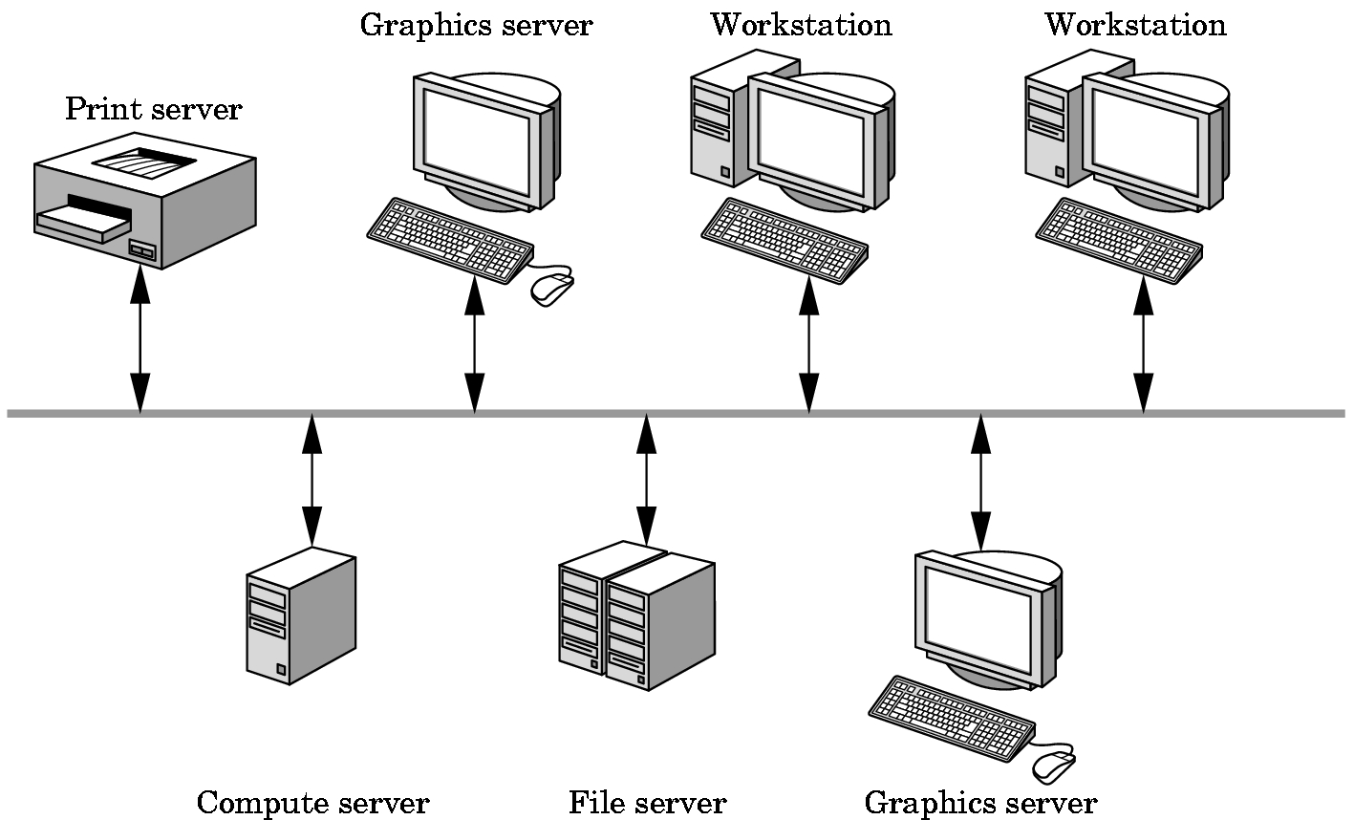
3. Clients and Servers
Def: Server
A Server is something that can perform tasks for clients.
Clients and Servers can be distributed over a network, or contained entirely within a computational unit.
OpenGL programs are clients that use the graphics server

Slide 20
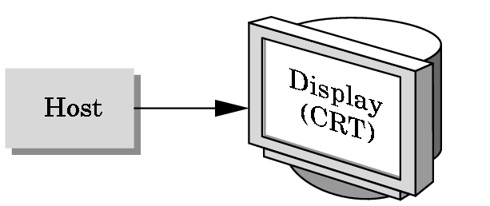
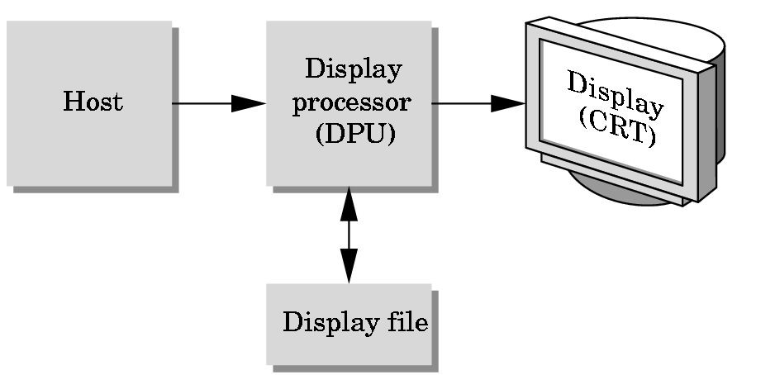
4. Display Lists
Display lists illustrate how we can use clients and servers on a network to improve interactive graphics performance.

Slide 21
Today:
The display processor has become the graphics server, and the user program has become a client.
The issue is not the refresh rate, but the amount of traffic between the client and the server
Now we can send graphical entities to a display in one of two ways:
immediate mode
retained-mode

Slide 22
Immediate Mode:
As soon as the program executes a statement that defines a primitive, that primitive is sent to the server for display and no memory of it is retained.
To redisplay it, you must redefine it and resend it
For complex objects in highly interactive applications, this process can cause considerable quantity of data to pass from the client to the server

Slide 23
Retained Mode:
We define an object once,
then put its description into a display list
The display list is stored in the server and redisplayed by a simple function call issued from the client to the server.
Advantages:
makes good use of hardware
(compute and graphics)
Disadvantages:
memory on the server
overhead of creating the lists

Slide 24
4.1 Definition and Execution of Display Lists
Display lists have much in common with ordinary files.
There must be a mechanism to define/create them as well as and add-to/manipulate them.
OpenGL has a small set of functions to manipulate display lists and placed only a few restrictions on display-list contents.
We will look at several examples to show their use.

Slide 25
Display lists are defined similarly to geometric primitives
Each display list must have a unique identifier
#define BOX 1
// GL_COMPILE says
glNewList(BOX, GL_COMPILE); // send to server
glBegin(GL_POLYGON); // but don’t display
glColor3f(1.0,0.0,0.0);
glVertex2f(-1.0, -1.0);
glVertex2f(-1.0, -1.0);
glVertex2f(-1.0, -1.0);
glVertex2f(-1.0, -1.0);
glEnd();
glEndList();

Slide 26
If we want an immediate display of the contents, we can use the flag
GL_COMPIL_AND_EXECUTE
Each time that we wish to draw the box on the server, we execute the following:
glCallList(BOX);
Because the call to set the drawing color to Red will still be in effect, you usually see display lists with the following at the beginning:
glPushAttrib(GL_ALL_ATTRIB_BITS);
glPushMatrix();
and the following at the end
glPopAttrib();
glPopMatrix();

Slide 27
5. Programming Event-Driven Input
In this section, we develop event-driven input through a number of simple examples that use the callback mechanism we introduced earlier.
We will examine various events that are recognized by the window system and write callback functions that govern how the application responds to those events.

Slide 28
5.1 Using the Pointing Device
Two types of events are associated with the pointing device
A move event
this is generated if the mouse is moved with one of the buttons depressed
A passive event
this is generated if the mouse is moved without a button being held down.
A mouse event occurs when one of the mouse buttons is either depressed or released

Slide 29
We specify the mouse callback function in main with the GLUT call
glutMouseFunc(mouse_callback_func);
The mouse callback function must have the form
void mouse_callback_func(int button, int state, int x, int y);
The code for this would look like
void mouse_callback_function(int button, int state, int x, int y)
{
if(button==GLUT_LEFT_BUTTON &&
state==GLUT_DOWN)
exit();
}

Slide 30
Note:
with this code, if any other mouse event had occurred, no response action would occur because no callbacks corresponding to the events has been defined (or registered).
Our next example
is going to draw a box at the mouse location when the left button is pushed
and terminate when the middle button is pushed.

Slide 31
int main(int argc, char **argv)
{
glutInit(&argc, argv);
glutInitDisplay(GLUT_SINGLE | GLUT_RGB);
glutCreateWindow(“square”);
myinit();
glutReshapeFunc(myReshape);
glutMouseFunc(mouse);
glutDisplayFunc(display);
glutMainLoop( );
}

Slide 32
Reshape event
is generated whenever the window is resized.
This is typically from user interaction.
We will discuss this later.
Display
we don’t need the display function since things are only drawn when the mouse button is pushed,
but it is required by GLUT, so our code will be:
void display ( ) { }

Slide 33
Mouse
void mouse(int btn, int state, int x, int y)
{
if(btn==GLUT_LEFT_BUTTON &&
state=GLUT_DOWN)
draw_square(x,y);
if(btn==GLUT_MIDDLE_BUTTON &&
state==GLUT_DOWN)
exit( );
}

Slide 34
Glsizei wh = 500, ww = 500;
Glfloat size = 3.0;
void myinit(void)
{
glViewport(0,0,ww,wh);
glMatrixMode(GL_PROJECTION);
glLoadIdentity( );
gluOrtho2D(0.0, (Gldouble)ww, 0.0, (Gldouble)wh);
glMatrixMode(GL_MODELVIEW);
glClearColor(0.0,0.0,0.0,0.0);
glClear(GL_COLOR_BUFFER_BIT);
glFlush( );
}

Slide 35
void drawSquare(int x, int y)
{
y=wh-y;
glColor3ub( (char)rand()%256, (char)rand()%256,
(char)rand()%256);
glBegin(GL_POLYGON);
glVertex2f( x+size, y+size);
glVertex2f( x-size, y+size);
glVertex2f( x-size, y-size);
glVertex2f( x+size, y-size);
glEnd( );
glFlush( );
}
Note: The position returned by the mouse is in the window’s system (origin is in the top left), hence we have to flip it

Slide 36
5.2 Window Events
If the window size changes, we have to consider three questions:
1. Do we redraw all the objects that were in the window before it was resized?
2. What do we do if the aspect ratio of the new window is different from that of the old window?
3. Do we change the size or attributes of new primitives if the size of the new window is different from that of the old?

Slide 37
In our example:
We ensure that squares of the same size are drawn, regardless of the size or shape of the window.
Therefore, we clear the screen each time it is resized and use the entire new window as our drawing area.
The reshape event returns the height and width of the new window
We use these to create a new OpenGL clipping window using gluOrtho2D,
As well as a new viewport with the same aspect ratio,
We then clear the window to black.

Slide 38
void myReshape(Glsizei w, Glsizei h)
{
glMatrixMode(GL_PROJECTION);
glLoadIdentity( );
gluOrtho2D(0.0, (Gldouble)ww, 0.0, (Gldouble)wh);
glMatrixMode(GL_MODELVIEW);
glLoadIdentity( );
glViewport(0,0,w,h);
glClearColor(0.0,0.0,0.0,0.0);
glClear(GL_COLOR_BUFFER_BIT);
glFlush( );
}

Slide 39
5.3 Keyboard Events
Keyboard events are generated when the mouse is in the window and one of the keys is depressed.
GLUT ignores key releases
All the keyboard callbacks are registered in a single callback function such as:
glutKeyboardFunc(keyboard);
For example:
void keyboard(unsigned char key, int x, int y)
{
if(key==‘q’ || key ==‘Q’) exit();
}

Slide 40
5.4 The Display and Idle Callbacks
glutDisplayFunc(display);
display is invoked when GLUT determines that the window should be redisplayed
window initially opened,
We can also tell GLUT to call it with
glutPostDisplay();
idle
The idle callback is invoked when there are no other events.
Its default is the null function.

Slide 41
5.5 Window Management
GLUT also supports both multiple windows and subwindows
We can open a second top-level window by
id=glutCreateWindow(“second window”);
The id allows us to select which window to work in by
glutSetWindow(id);
We can make this window have different properties by invoking the glutInitDisplayMode before glutCreateWindow.
And each window can have its own set of callback functions, because callback specifications refer to the present window.

Slide 42
6. Menus
GLUT provides pop-up menus that we can use with the mouse to create sophisticated interactive applications.
Using the menus involves taking a few simple steps
define the entries
link the menu to a mouse button
define a callback for each menu entry.

Slide 43
glutCreateMenu(demo_menu);
glutAddMenuEntry(“quit”,1);
glutAddMenuEntry(“increase square size”,2);
glutAddMenuEntry(“decrease square size”,3);
glutAttachMenu(GLUT_RIGHT_BUTTON);
Our callback function is:
void demo_menu(int id)
{
if(id==1) exit( );
else if(id==2)size = 2*size;
else if (size>1) size = size/2;
glutPostRedisplay( );
}

Slide 44
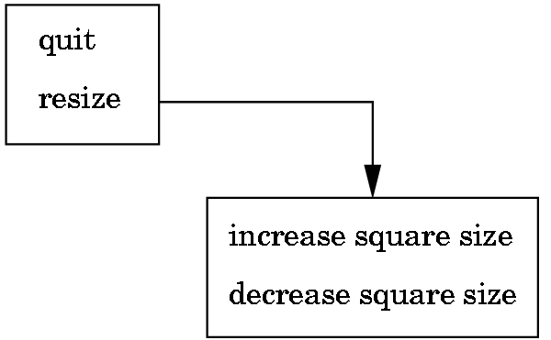
GLUT also supports hierarchical menus
sub_menu = glutCreateMenu(size_menu);
glutAddMenuEntry(“increase square size”,2);
glutAddMenuEntry(“decrease square size”,3);
glutCreateMenu(top_menu);
glutAddMenuEntry(“quit”,1);
glutAddSubMenu(“Resize”, sub_menu);
glutAttachMenu(GLUTRIGHTBUTTON);

Slide 45
7. Picking
Picking is an input operation that allows the user to identify an object on the display.
Although the action uses the pointing device, the information the user wants is not a position.
A pick device is considerably more difficult to implement on a modern system than is a locator
The text gives some ideas

Slide 46
8. A Simple Paint Program
Any paint program should demonstrate most of the following features:
ability to work with geometric objects
ability to manipulate pixels
provide control of attributes (color, ...)
include menus for controlling the application
behave correctly when the window is moved or resized.

Slide 47
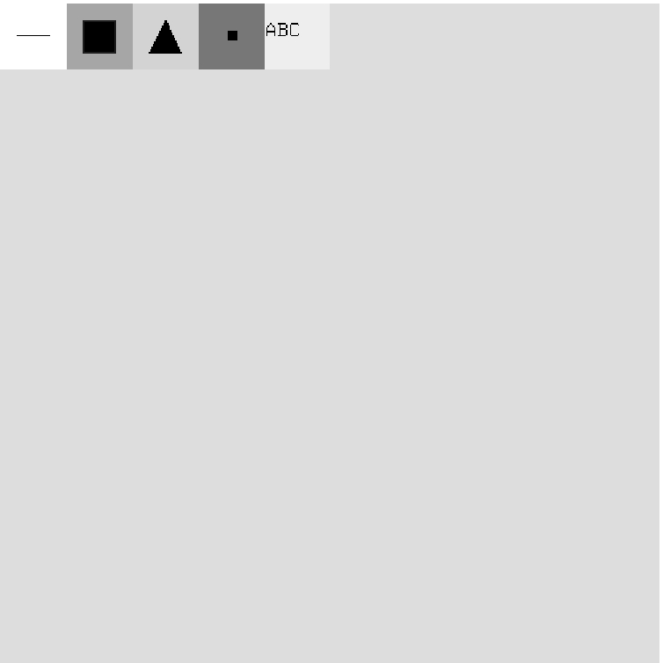
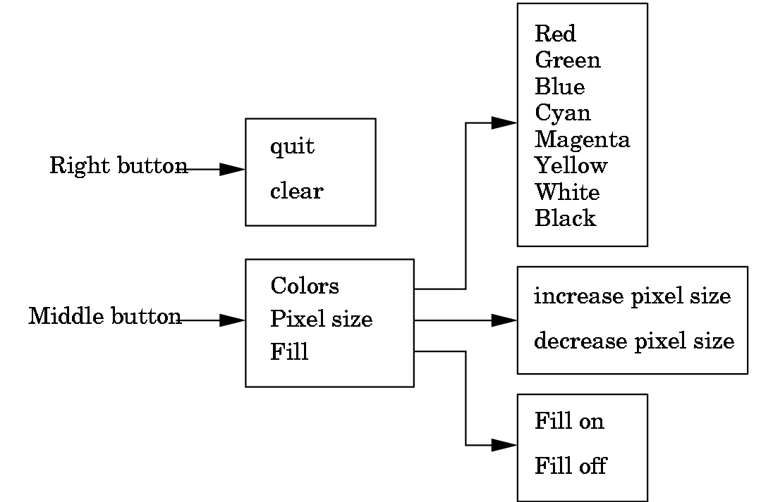

Slide 48
9. Animating Interactive Programs
So far our programs have been static
Once a primitive was placed on the display its image did not change until the screen was cleared.
Suppose that we want to create a picture in which one or more objects are changing or moving, and thus their images must change.

Slide 49
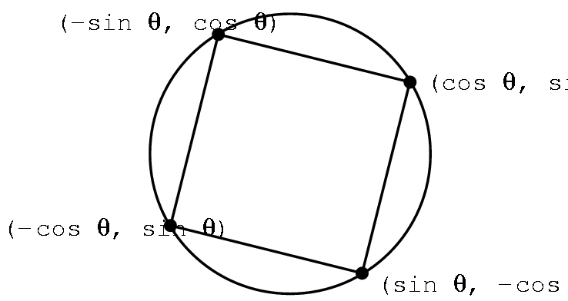
9.1 The Rotating Square
Consider the rotating two dimensional point where
x = cos θ,
y = sin θ

Slide 50
void display( )
{
glClear( );
glBegin(GL_POLYGON);
thetar = theta/((2*3.14159)/360.0);
glVertex2f(cos(thetar), sin(thetar));
glVertex2f(sin(thetar), cos(thetar));
glVertex2f(-cos(thetar), -sin(thetar));
glVertex2f(sin(thetar), -cos(thetar));
glEnd( );
}

Slide 51
Now suppose we want to increase theta by a fixed amount whenever nothing else is happening.
glutIdleFunc(idle);
void idle( )
{
theta+=2;
if(theta >=360.0) theta-=360.0;
glutPostRedisplay( );
}

Slide 52
So, what would this do?
glutMouseFunc(mouse);
void mouse(int button, int state, int x, int y)
{
if(button==GLUT_LEFT && state==GLUT_DOWN)
glutIdleFunc(idle);
if(button==GLUT_MIDDLE && state==GLUT_DOWN)
glutIdleFunc(NULL);
}

Slide 53
9.2 Double Buffering
Why do we want double buffering?
In main we request a double buffered display by:
glutInitDisplayMode(GLUT_RGB | GLUT_DOUBLE)
After we have finished drawing, we call
glutSwapBuffers( );

Slide 54
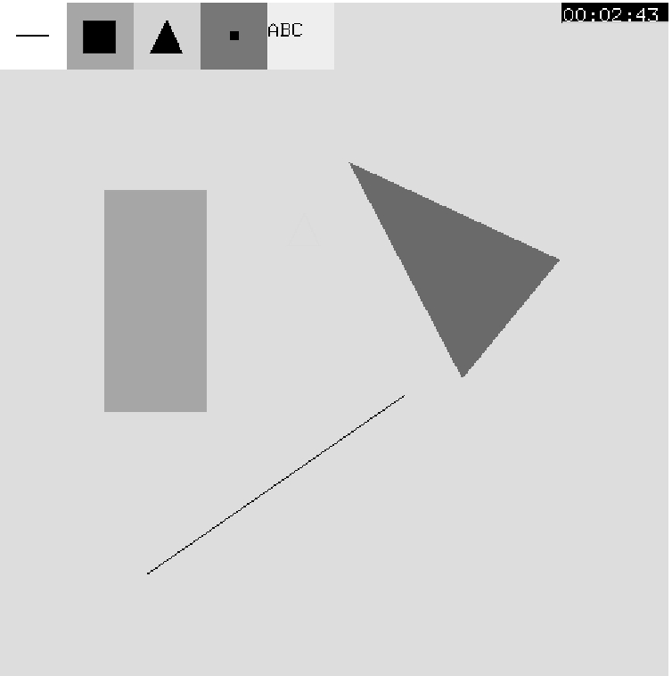
9.3 Other Buffering Problems
Suppose we want to add an elapsed time clock
single buffer causes clock to flicker
double buffer causes drawing to flicker
answer is to draw the items to both buffers
See Chapter 9 for details

Slide 55
10. Design of Interactive Programs
A good interactive program should have:
A smooth display (no flicker or artifacts of refresh)
A variety of interactive devices on the display
A variety of methods for entering and displaying information
An easy to use interface that does not require substantial effort to learn.
Feedback to the user.
Tolerance for user errors
A design that incorporates consideration of both visual and motor properties of humans.

Slide 56
10.1 Toolkits, Widgets, and the Frame Buffer
The paint program used interactive tools, such as pop-up menus that were provided by GLUT.
There are many more possibilities, such as slide-bars, dials, hot areas on the screen, sound, and icons
Usually these tools are supplied with various toolkits, although there is nothing to prevent you from writing your own.
Designing our own widget set will be much easier after pixel operations are introduced in Chapter 9
most of these operations are described in terms of the contents of the frame buffer
bit-block transfer operations (bitblt)

Slide 57
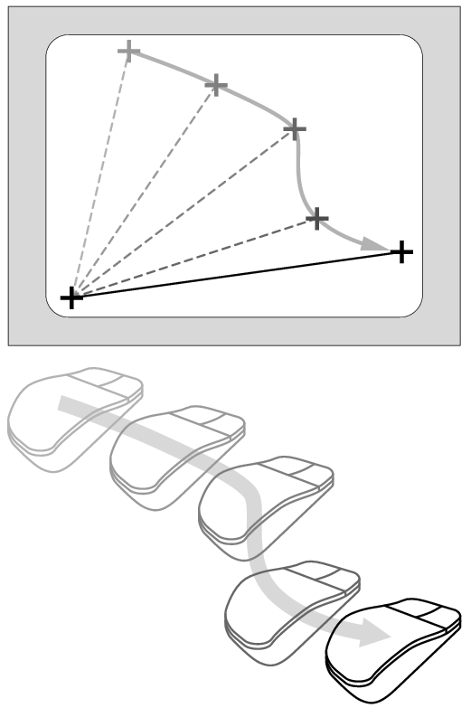
Rubberbanding is one of those techniques
Note that before each new line segment is drawn, the previous line segment must be erased.
Usually the rubberbanding begins when the mouse button is depressed and continues until the button is released.
Other objects that are drawn interactively with rubberbanding include rectangles and circles.

Slide 58
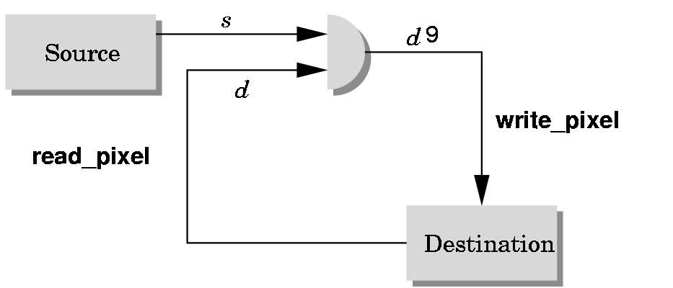
Writing Modes(LOGIC OPERATIONS)
bitwise logical operation
application
‘
frame buffer

Slide 59
XOR write
Usual (default) mode: source replaces destination (d’ = s)
Cannot write temporary lines this way because we cannot recover what was “under” the line in a fast simple way
Exclusive OR mode (XOR) (d’ = d ⊕ s)
x ⊕ y ⊕ x =y
Hence, if we use XOR mode to write a line, we can draw it a second time and line is erased!

Slide 60
Curves and Surfaces

Slide 61
Objectives
Introduce types of curves and surfaces
Explicit
Implicit
Parametric
Strengths and weaknesses
Discuss Modeling and Approximations
Conditions
Stability

Slide 62
Escaping Flatland
Until now we have worked with flat entities such as lines and flat polygons
Fit well with graphics hardware
Mathematically simple
But the world is not composed of flat entities
Need curves and curved surfaces
May only have need at the application level
Implementation can render them approximately with flat primitives

Slide 63
Modeling with Curves
interpolating data point
data points
approximating curve

Slide 64
What Makes a Good Representation?
There are many ways to represent curves and surfaces
Want a representation that is
Stable
Smooth
Easy to evaluate
Must we interpolate or can we just come close to data?
Do we need derivatives?

Slide 65
Explicit Representation
Most familiar form of curve in 2D
y=f(x)
Cannot represent all curves
Vertical lines
Circles
Extension to 3D
y=f(x), z=g(x)
The form z = f(x,y) defines a surface
y
x
y
x
z

Slide 66
Implicit Representation
Two dimensional curve(s)
g(x,y)=0
Much more robust
All lines ax+by+c=0
Circles x²+y²-r²=0
Three dimensions g(x,y,z)=0 defines a surface
Intersect two surface to get a curve
In general, we cannot solve for points that satisfy

Slide 67
Algebraic Surface
Quadric surface 2 ≥ i+j+k
At most 10 terms
Can solve intersection with a ray by
reducing problem to solving quadratic equation

Slide 68
Parametric Curves
Separate equation for each spatial variable
x=x(u)
y=y(u)
z=z(u)
For u_{max} ≥ u ≥ u_{min} we trace out a curve in two or three dimensions
p(u)=[x(u), y(u), z(u)]^{T}
p(u)
p(u_{max})
p(u_{min})

Slide 69
Selecting Functions
Usually we can select “good” functions
not unique for a given spatial curve
Approximate or interpolate known data
Want functions which are easy to evaluate
Want functions which are easy to differentiate
Computation of normals
Connecting pieces (segments)
Want functions which are smooth

Slide 70
Parametric Lines
We can normalize u to be over the interval (0,1)
Line connecting two points p₀ and p₁
p(1)= p₁
p(u)=(1-u)p₀+up₁
p(0) = p₀
p(1)= p₀ +d
Ray from p₀ in the direction d
p(u)=p₀+ud
d
p(0) = p₀

Slide 71
Parametric Surfaces
Surfaces require 2 parameters
x=x(u,v)
y=y(u,v)
z=z(u,v)
p(u,v) = [x(u,v), y(u,v), z(u,v)]^{T}
Want same properties as curves:
Smoothness
Differentiability
Ease of evaluation
y
p(u,1)
p(0,v)
p(1,v)
x
z
p(u,0)

Slide 72
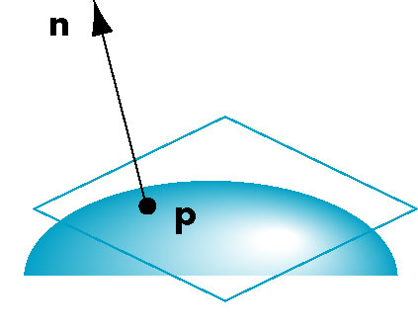
Normals
We can differentiate with respect to u and v to obtain the normal at any point p

Slide 73
Parametric Planes
n
point-vector form
r
p(u,v)=p₀+uq+vr
n = q x r
q
p₀
n
three-point form
p₂
q = p₁ – p₀
r = p₂ – p₀
p₁
p₀

Slide 74
Parametric Sphere
x(u,v) = r cos θ sin φ
y(u,v) = r sin θ sin φ
z(u,v) = r cos φ
360 ≥ θ ≥ 0
180 ≥ φ ≥ 0
constant: circles of constant longitude
φ constant: circles of constant latitude
differentiate to show n = p

Slide 75
Curve Segments
After normalizing u, each curve is written
p(u)=[x(u), y(u), z(u)]^{T}, 1 ≥ u ≥ 0
In classical numerical methods, we design a single global curve
In computer graphics and CAD, it is better to design small connected curve segments
p(u)
join point p(1) = q(0)
q(1)
q(u)
p(0)

Slide 76
Parametric Polynomial Curves
If N=M=K, we need to determine 3(N+1) coefficients
Equivalently we need 3(N+1) independent conditions
Noting that the curves for x, y and z are independent,
we can define each independently in an identical manner
We will use the form
where p can be any of x, y, z

Slide 77
Why Polynomials
Easy to evaluate
Continuous and differentiable everywhere
Must worry about continuity at join points including continuity of derivatives
p(u)
q(u)
join point p(1) = q(0)
but p’(1) ≠ q’(0)

Slide 78
Cubic Parametric Polynomials
N=M=L=3, gives balance between ease of evaluation and flexibility in design
Four coefficients to determine for each of x, y and z
Seek four independent conditions for various values of u resulting in 4 equations in 4 unknowns for each of x, y and z
Conditions are a mixture of continuity requirements at the join points and conditions for fitting the data

Slide 79
Cubic Polynomial Surfaces
p(u,v)=[x(u,v), y(u,v), z(u,v)]^{T}
where
p is any of x, y or z
Need 48 coefficients ( 3 independent sets of 16) to
determine a surface patch

Slide 80
Matrix-Vector Form
define
then

Slide 81
Interpolating Curve
p₁
p₃
p₀
p₂
Given four data (control) points p₀ , p₁ ,p₂ , p₃
determine cubic p(u) which passes through them
Must find c₀ ,c₁ ,c₂ , c₃

Slide 82
Interpolation Equations
apply the interpolating conditions at u=0, 1/3, 2/3, 1
p₀=p(0)=c₀
p₁=p(1/3)=c₀+(1/3)c₁+(1/3)²c₂+(1/3)³c₂
p₂=p(2/3)=c₀+(2/3)c₁+(2/3)²c₂+(2/3)³c₂
p₃=p(1)=c₀+c₁+c₂+c₂
or in matrix form with p = [p₀ p₁ p₂ p₃]^{T}
p=Ac

Slide 83
Interpolation Matrix
Solving for c we find the interpolation matrix
c=M_{I}p
Note that M_{I} does not depend on input data and
can be used for each segment in x, y, and z

Slide 84
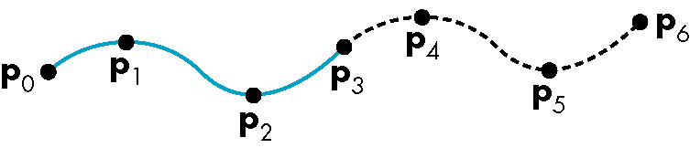
Interpolating Multiple Segments
use p = [p₃ p₄ p₅ p₆]^{T}
use p = [p₀ p₁ p₂ p₃]^{T}
Get continuity at join points but not
continuity of derivatives

Slide 85
Blending Functions
Rewriting the equation for p(u)
p(u)=u^{T}c=u^{T}M_{I}p = b(u)^{T}p
where b(u) = [b₀(u) b₁(u) b₂(u) b₃(u)]^{T} is
an array of blending polynomials such that
p(u) = b₀(u)p₀+ b₁(u)p₁+ b₂(u)p₂+ b₃(u)p₃
b₀(u) = -4.5(u-1/3)(u-2/3)(u-1)
b₁(u) = 13.5u (u-2/3)(u-1)
b₂(u) = -13.5u (u-1/3)(u-1)
b₃(u) = 4.5u (u-1/3)(u-2/3)

Slide 86
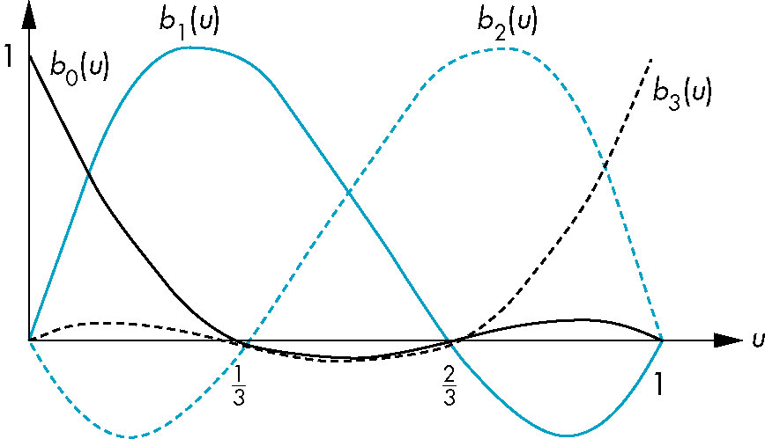
Blending Functions
These functions are not smooth
Hence the interpolation polynomial is not smooth

Slide 87
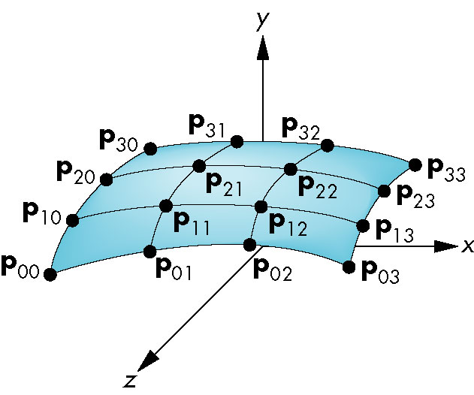
Interpolating Patch
Need 16 conditions to determine the 16 coefficients c_{ij}
Choose at u,v = 0, 1/3, 2/3, 1

Slide 88
Matrix Form
Define v = [1 v v² v³]^{T}
C = [c_{ij}] P = [p_{ij}]
p(u,v) = u^{T}Cv
If we observe that for constant u (v), we obtain
interpolating curve in v (u), we can show
C=M_{I}PM_{I}
p(u,v) = u^{T}M_{I}PM_{I}^{T}v

Slide 89
Blending Patches
Each b_{i}(u)b_{j}(v) is a blending patch
Shows that we can build and analyze surfaces
from our knowledge of curves

Slide 90
Other Types of Curves and Surfaces
How can we get around the limitations of the interpolating form
Lack of smoothness
Discontinuous derivatives at join points
We have four conditions (for cubics) that we can apply to each segment
Use them other than for interpolation
Need only come close to the data

Slide 91
Hermite Form
p’(0)
p’(1)
p(0)
p(1)
Use two interpolating conditions and
two derivative conditions per segment
Ensures continuity and first derivative
continuity between segments

Slide 92
Equations
Interpolating conditions are the same at ends
p(0) = p₀ = c₀
p(1) = p₃ = c₀+c₁+c₂+c₃
Differentiating we find p’(u) = c₁+2uc₂+3u²c₃
Evaluating at end points
p’(0) = p’₀ = c₁
p’(1) = p’₃ = c₁+2c₂+3c₃

Slide 93
Matrix Form
Solving, we find c=M_{H}q where M_{H} is the Hermite matrix

Slide 94
Blending Polynomials
p(u) = b(u)^{T}q
Although these functions are smooth, the Hermite form
is not used directly in Computer Graphics and CAD
because we usually have control points but not derivatives
However, the Hermite form is the basis of the Bezier form

Slide 95
Parametric and Geometric Continuity
We can require the derivatives of x, y,and z to each be continuous at join points (parametric continuity)
Alternately, we can only require that the tangents of the resulting curve be continuous (geometry continuity)
The latter gives more flexibility as we have need satisfy only two conditions rather than three at each join point

Slide 96
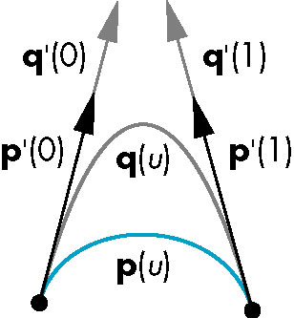
Example
Here the p and q have the same tangents at the ends of the segment but different derivatives
Generate different
Hermite curves
This techniques is used
in drawing applications

Slide 97
Higher Dimensional Approximations
The techniques for both interpolating and Hermite curves can be used with higher dimensional parametric polynomials
For interpolating form, the resulting matrix becomes increasingly more ill-conditioned and the resulting curves less smooth and more prone to numerical errors
In both cases, there is more work in rendering the resulting polynomial curves and surfaces

Slide 98
Bezier and Spline Curves and Surfaces

Slide 99
Objectives
Introduce the Bezier curves and surfaces
Derive the required matrices
Introduce the B-spline and compare it to the standard cubic Bezier

Slide 100
Bezier’s Idea
In graphics and CAD, we do not usually have derivative data
Bezier suggested using the same 4 data points as with the cubic interpolating curve to approximate the derivatives in the Hermite form

Slide 101
Approximating Derivatives
p₁
p₂
p₁ located at u=1/3
p₂ located at u=2/3
slope p’(0)
slope p’(1)
p₀
p₃
u

Slide 102
Equations
Interpolating conditions are the same
p(0) = p₀ = c₀
p(1) = p₃ = c₀+c₁+c₂+c₃
Approximating derivative conditions
p’(0) = 3(p₁- p₀) = c₀
p’(1) = 3(p₃- p₂) = c₁+2c₂+3c₃
Solve four linear equations for c=M_{B}p

Slide 103
Bezier Matrix
p(u) = u^{T}M_{B}p = b(u)^{T}p
blending functions

Slide 104
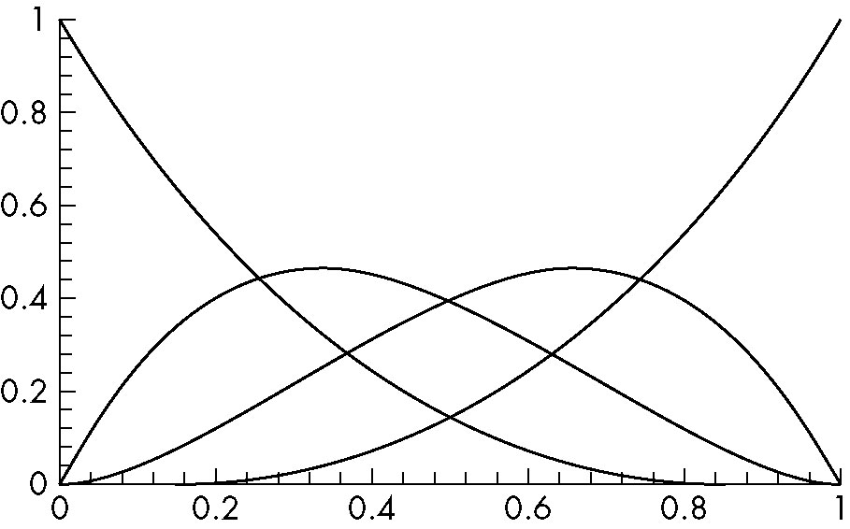
Blending Functions
Note that all zeros are at 0 and 1 which forces
the functions to be smooth over (0,1)

Slide 105
Bernstein Polynomials
The blending functions are a special case of the Bernstein polynomials
These polynomials give the blending polynomials for any degree Bezier form
All zeros at 0 and 1
For any degree they all sum to 1
They are all between 0 and 1 inside (0,1)

Slide 106
Convex Hull Property
The properties of the Bernstein polynomials ensure that all Bezier curves lie in the convex hull of their control points
Hence, even though we do not interpolate all the data, we cannot be too far away
p₁
p₂
convex hull
Bezier curve
p₀
p₃

Slide 107
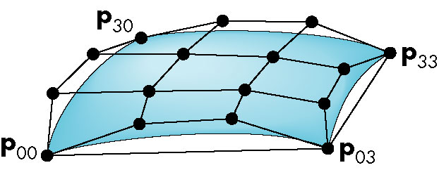
Bezier Patches
Using same data array P=[p_{ij}] as with interpolating form
Patch lies in
convex hull

Slide 108
Analysis
Although the Bezier form is much better than the interpolating form, we have the derivatives are not continuous at join points
Can we do better?
Go to higher order Bezier
More work
Derivative continuity still only approximate
Supported by OpenGL
Apply different conditions
Tricky without letting order increase

Slide 109
B-Splines
Basis splines: use the data at p=[p_{i-2} p_{i-1} p_{i} p_{i-1}]^{T} to define curve only between p_{i-1} and p_{i}
Allows us to apply more continuity conditions to each segment
For cubics, we can have continuity of function, first and second derivatives at join points
Cost is 3 times as much work for curves
Add one new point each time rather than three
For surfaces, we do 9 times as much work

Slide 110
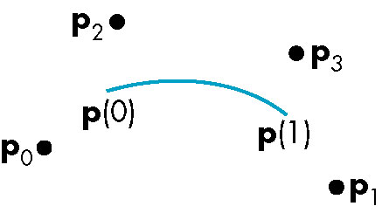
Cubic B-spline
p(u) = u^{T}M_{S}p = b(u)^{T}p

Slide 111
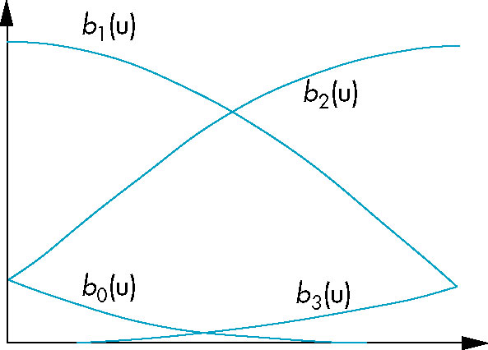
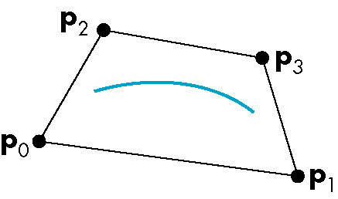
Blending Functions
convex hull property

Slide 112
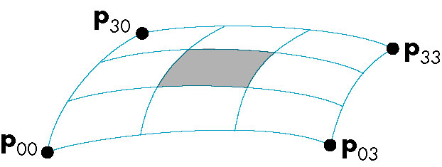
B-Spline Patches
defined over only 1/9 of region

